Slide 1
1.4 Assignment: Capstone Project
Team #4
Team Members: Abdullah Al-Jaberi, Alejandro Benitez, Anjali Desai, Derin Sabuncuoglu
Notes:
Slide 1 Derin
Slide 2 Anjali
Slide 3 Abdullah
Slide 4 Alejandro
Slide 5 Alejandro
Slide 6 Abdullah
Slide 7 Anjali
Slide 8 Derin
Slide 9 Abdullah

Slide 2
Table of Contents
1
Overview of Original Model
2
Enhancements and Benefits
3
4
Comparisons of Different Algorithms
Findings from Data Exploration
5
User Feedback
6
Future Enhancements

Slide 3
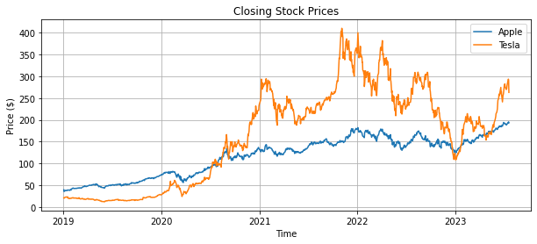
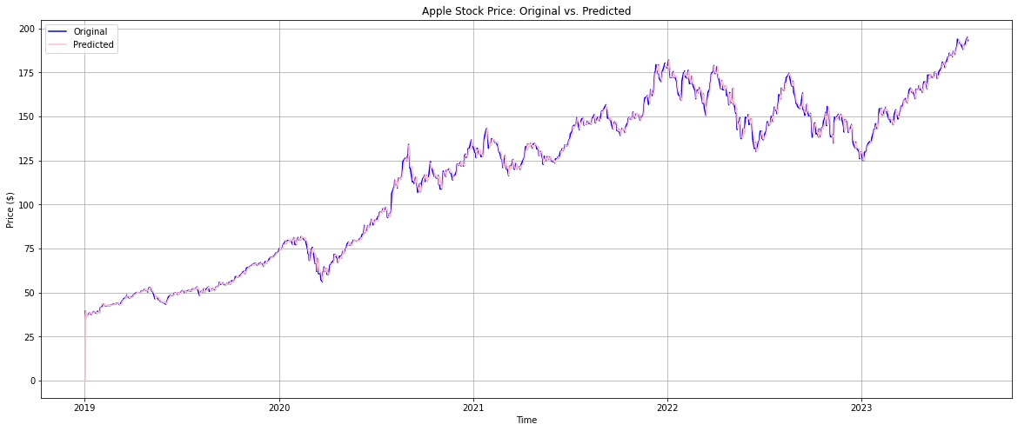
Overview of Original Model:
Using yfinance package, extracts historical data of stocks from 2019 to 2023.
Creation and fitting of ARIMA model for both companies.
Comparing closing prices with predicted prices on a graph.
Calculating error percentage.
Forecasting future values.
Notes:
Speaker Notes: DERIN
Using the yfinance package, we extract historical stock data for Apple and Tesla from 2019 to 2023. This data forms the basis for our analysis and modeling. We then create and fit an ARIMA model for both companies, capturing patterns in stock price movements to make accurate predictions.Next, we compare actual closing prices with predicted prices on a graph to assess the model's performance. We calculate the error percentage to quantify the accuracy of the model, with a lower percentage indicating higher accuracy. Finally, we forecast future values, enabling investors to anticipate market movements and make informed decisions. This helps in optimizing portfolios and achieving financial goals.

Slide 4
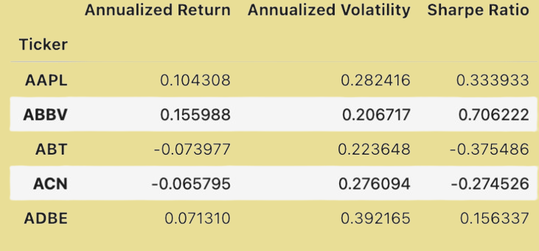
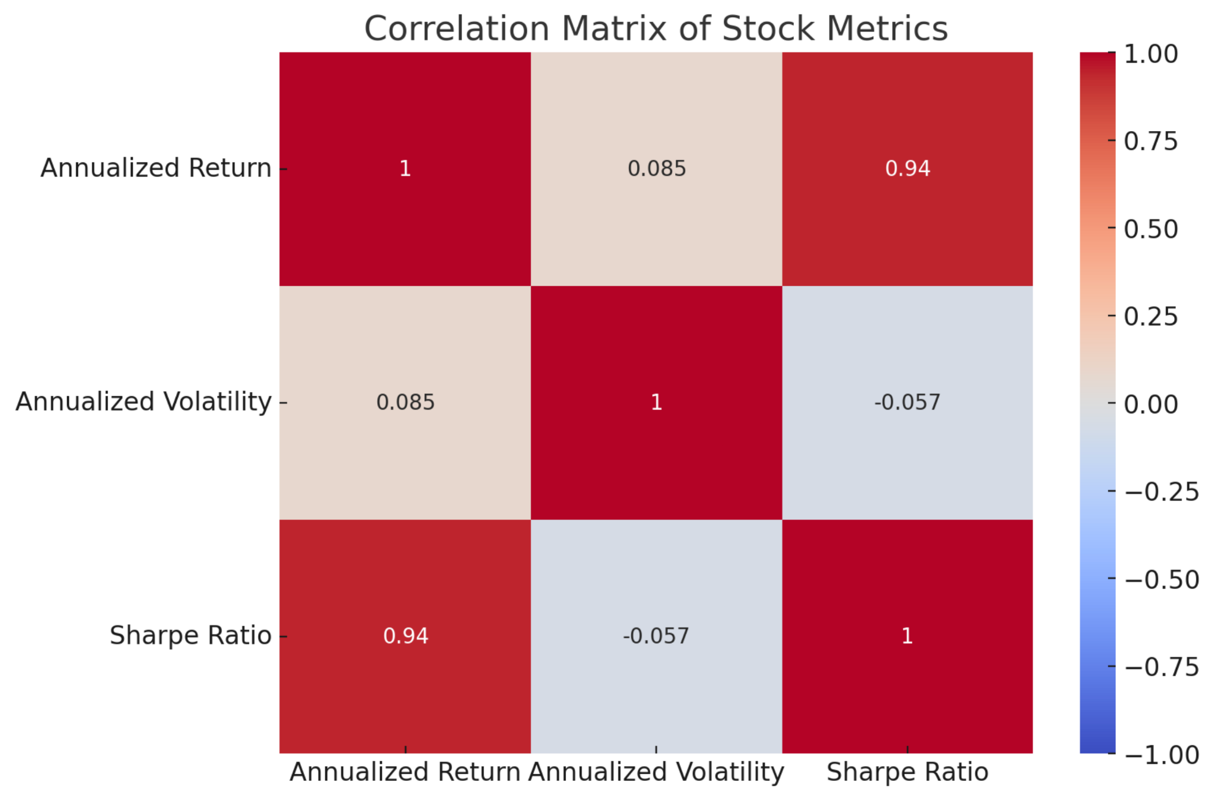
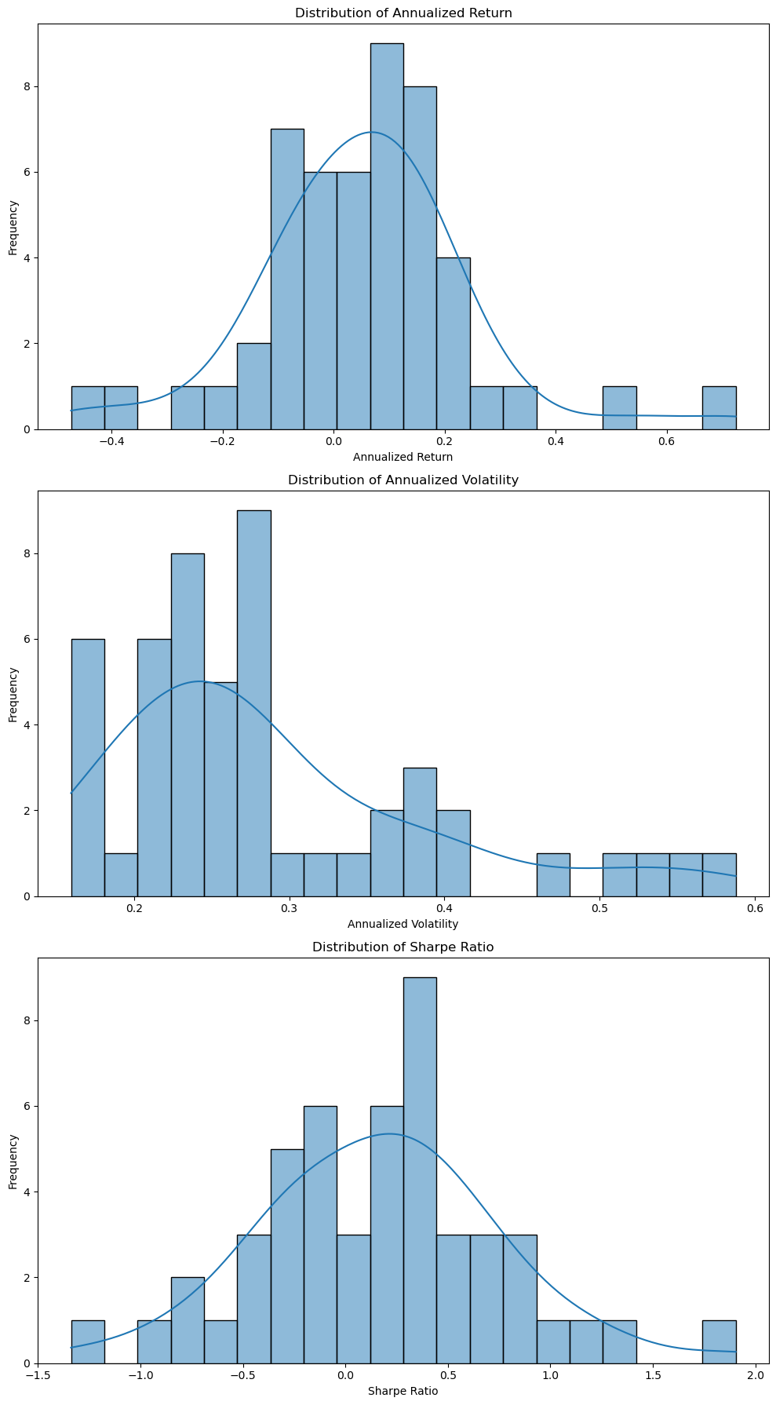
Enhancements & Benefits
Enhanced Data Preprocessing:
Capping Outliers
Filtering Data
Enhanced Metrics Calculation:
Annualized Return & Volatility
Sharpe Ratio Calculation
Visualization Enhancements:
Distribution Plots
Correlation Matrix
Notes:
ANJALI
Enhanced Data Preprocessing: By capping outliers, we reduce the impact of extreme values, ensuring more reliable results. Extracting data specific to each company allows for focused analysis on individual stock performance, making it more accurate and relevant.
Advanced Metrics Calculation: Annualized return and volatility standardize performance measurement, enabling meaningful comparisons. The Sharpe ratio adjusts returns based on risk, helping investors understand returns per unit of risk, which is crucial for informed investment decisions.
Visualization Enhancements: Visualizing distributions of returns, volatilities, and Sharpe ratios helps identify patterns and trends, aiding strategic decision-making. Understanding metric correlations supports effective portfolio diversification and risk management.

Slide 5
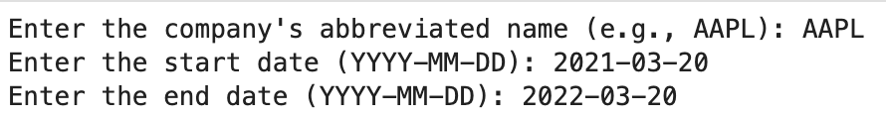
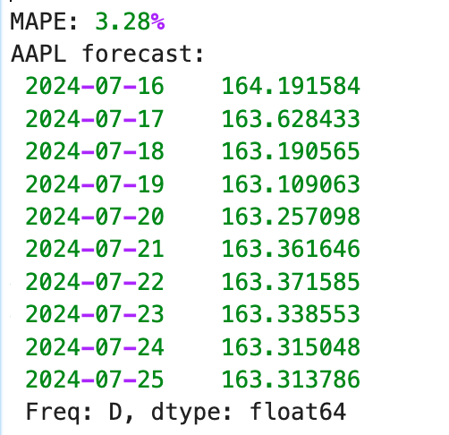
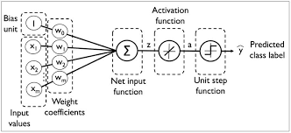
Enhancements & Benefits
User Interaction
User Inputs
Risk Assessment
Improved Modeling Techniques
ARIMA Model Tuning
Future Value Forecasting
Deep Learning Integration
Using MLP
Ensemble Learning
Notes:
ABDULLAH
User Interaction: Customizable inputs for company, start date, and end date make the tool user-friendly and relevant to specific interests. Tailoring investment recommendations based on risk tolerance ensures advice aligns with financial goals, enhancing user satisfaction and decision-making.
Improved Modeling Techniques: Fine-tuning ARIMA model parameters improves forecast accuracy, leading to reliable forecasts for planning. Forecasting future stock prices helps investors anticipate market movements and make proactive decisions, crucial for both short-term and long-term investments.
Machine Learning Integration: A preprocessing pipeline standardizes numeric and categorical data, enhancing model performance. GridSearchCV optimizes hyperparameters, ensuring the machine learning model is accurate and robust, leading to better predictions and insights.

Slide 6
Findings from Data Exploration
Annualized Return:
Slightly sharper curve due to smaller standard deviation.
The graph is normally distributed, and there is less variability in the data
Annualized Volatility:
The mean is skewed to the left, indicating a bias in the data.
The standard deviation is larger, and curve is flatter.
Sharpe Ratio:
Normally distributed graph with slightly larger standard deviation.
Notes:
ALEJANDRO
While exploring the data, we calculated the distribution of Annualized Return, Annualized Volatility, and Sharpe Ratio.
Annualized Return: The curve is slightly sharper due to a smaller standard deviation, indicating less variability in the data. The graph is normally distributed, making it easier to predict future performance. However, it does show a slight positive skew as the peak of the curve is to the right of 0, indicating that more stocks have positive annualized returns.
Annualized Volatility: The mean is skewed to the left, indicating a bias in the data. The standard deviation is larger, resulting in a flatter curve, which suggests higher risk and unpredictability.
Sharpe Ratio: The graph is mostly normally distributed with a slightly larger standard deviation, which helps in assessing the performance of the investments more accurately. This distribution is also slightly right-skewed, which implies that while risk-adjusted returns are generally modest, some stocks achieve much higher risk-adjusted returns which moves the curve to the right..

Slide 7
Findings from Data Exploration
Correlation Matrix:
High Correlation:
Annualized Return - Sharpe Ratio
Low Correlation:
Annualized Return - Annualized Volatility
Annualized Volatility - Sharpe Ratio
Notes:
ALEJANDRO
The heatmap shows that there is a positive correlation between annualized return and Sharpe ratio (0.94), suggesting that stocks with higher returns tend to have higher risk-adjusted returns. This is expected, as the Sharpe ratio incorporates return in its calculation.
The correlation between annualized return and annualized volatility is relatively weak (0.085), suggesting that the return and volatility are not nearly related in this dataset. Annualized Volatility seems to also have no correlation with Sharpe Ratio ( at -0.057), there is a very slight inverse relationship between volatility and risk-adjusted returns, but it is almost negligible.

Slide 8
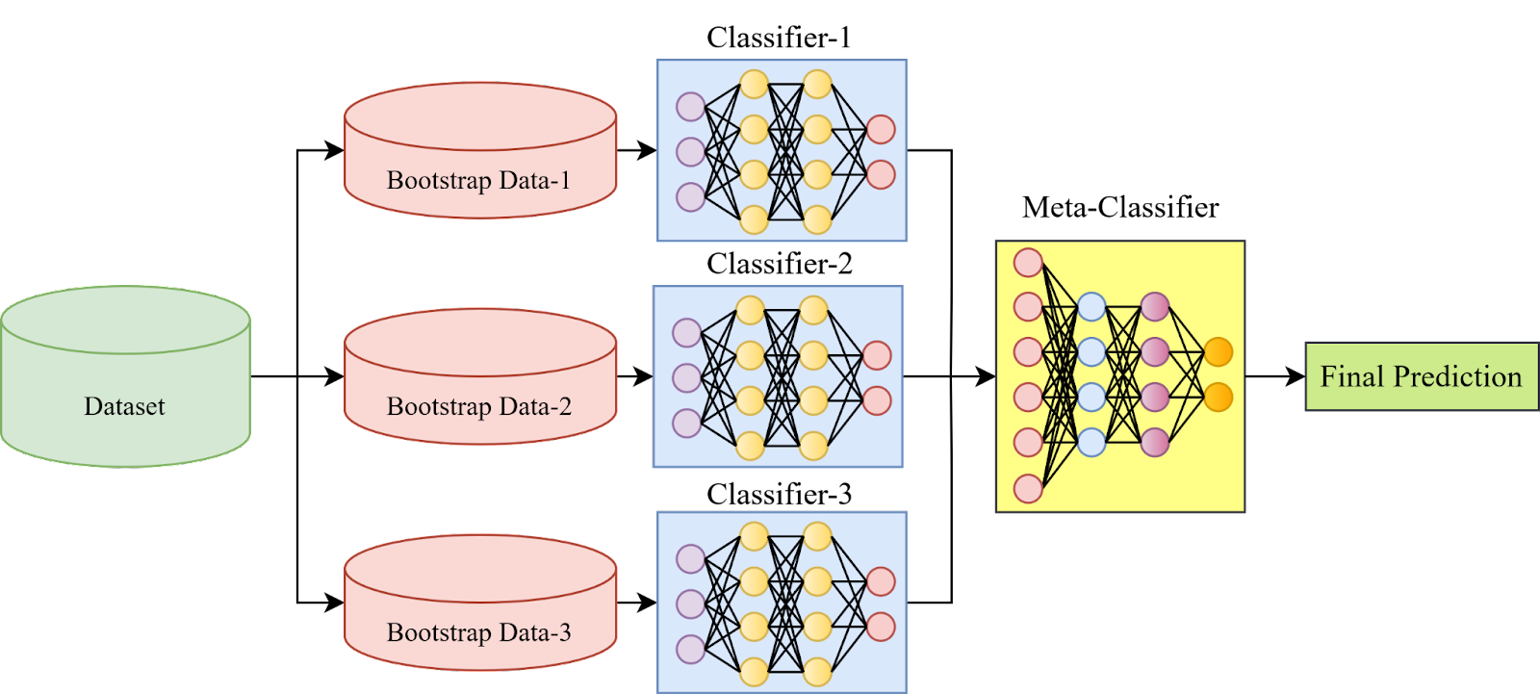
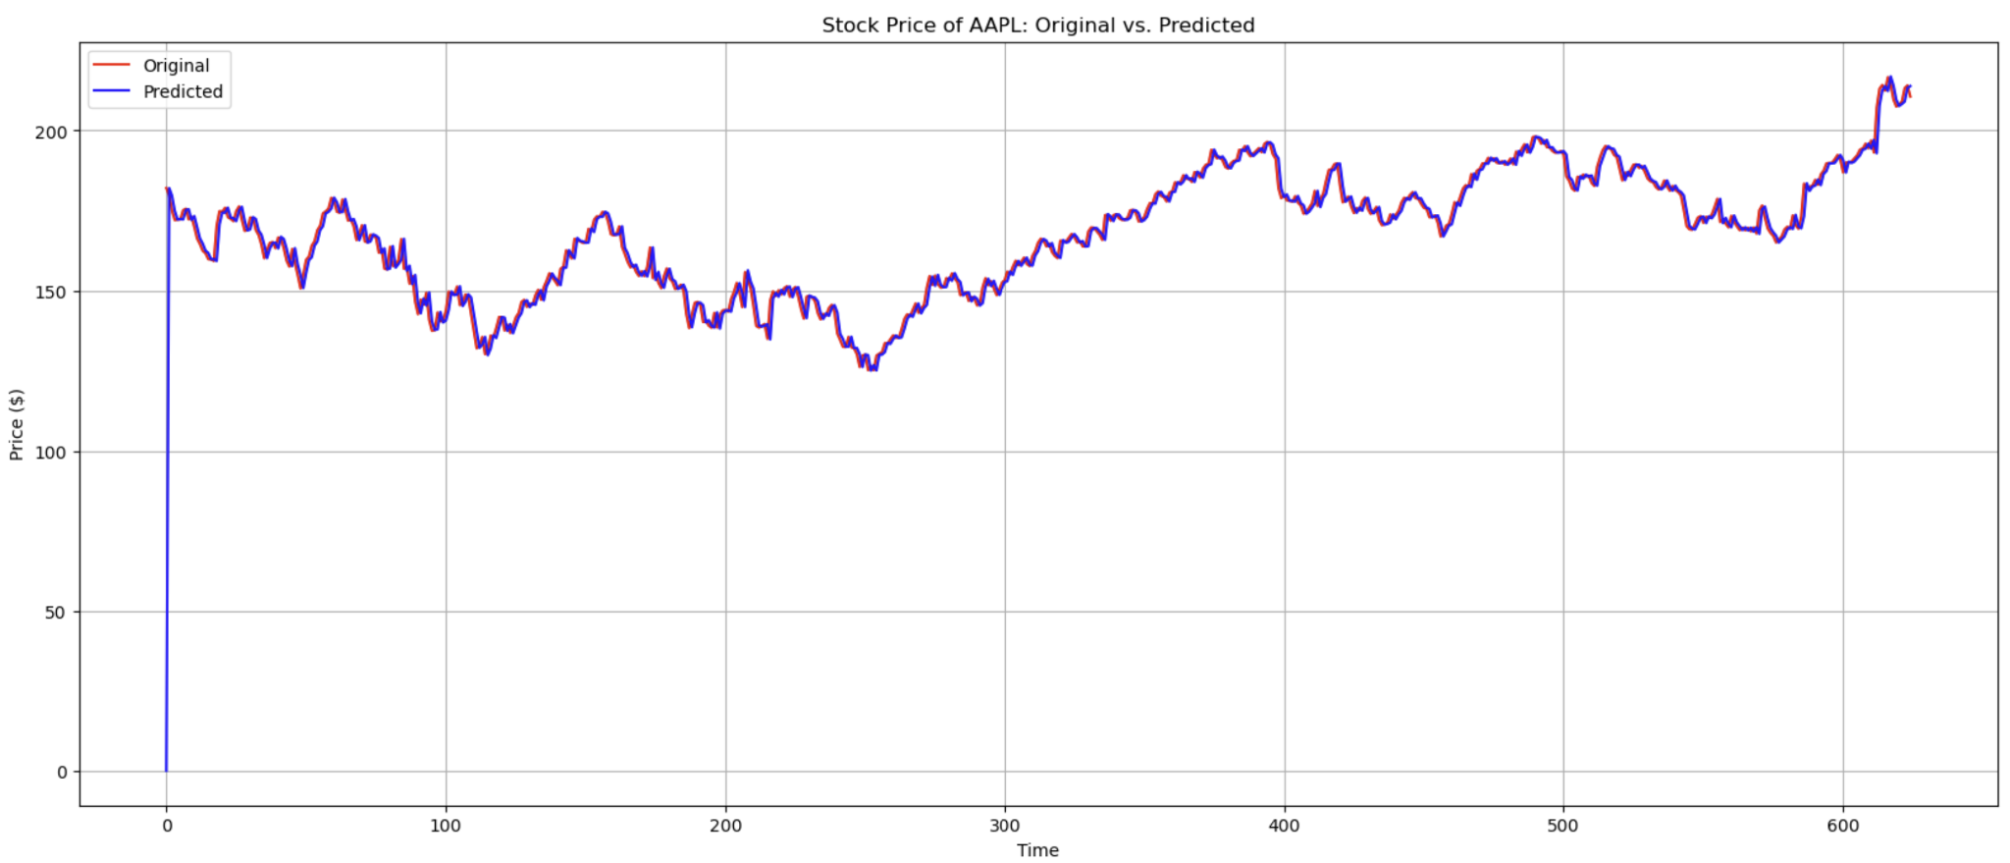
Comparisons of Different Algorithms
Neural Network (Ensemble RNN and MPL)*Enhanced:
Displays best parameters optimized through GridSearchCV
Predicts closing prices based on training and testing data
Calculates mean squared error (MSE) to assess prediction accuracy
Compares predicted and actual prices in a graph
ARIMA Model *Original:
Takes input of company’s name, start and end dates
Predicts closing prices
Displays absolute mean error percentage
Forecasts future values
Notes:
ABDULLAH
In this slide, we compare the traditional ARIMA model with an ensemble of neural networks, specifically using MLP (Multi-layer Perceptron) and RNN (Recurrent Neural Network). The ARIMA model, leveraging time series analysis, provides robust predictions based on historical data input. It calculates the absolute mean error percentage to gauge accuracy and forecasts future stock values, aiding in strategic planning. Using both RNN and MLP in an ensemble can be more effective than using just one of them. RNNs excel at capturing temporal dependencies in time series data, while MLPs can effectively learn complex non-linear relationships. By combining their predictions, we leverage the strengths of both models, potentially improving overall model performance. The ensemble approach mitigates the weaknesses of each individual model, providing more robust predictions. Our ensemble neural network, optimized through GridSearchCV, predicts closing prices with reduced mean squared error. Visual comparisons against actual prices help visualize model performance and support informed decision-making in investment strategies. This approach highlights the efficiency gains achieved through ensemble learning over traditional methods."

Slide 9
User Interaction and Feedback
Takes user input for multiple stocks to predict their prices.
Collects user ratings and suggestions after showing predictions.
Calculates prediction accuracy (MAPE) and recommends buying based on risk level and stock volatility.
Notes:
ANJALI
Our system is designed to handle multiple stock inputs simultaneously, which allows us to accurately predict their future prices. Once predictions are generated, we encourage user feedback through ratings and suggestions to continually improve our models in the future.
To assess the accuracy of our predictions, we used Mean Absolute Percentage Error. This helps us gauge how closely our predictions align with actual stock prices.
Our system also factors in risk levels and stock volatility when recommending whether the use should buy stocks. By considering these factors, we are able to pro informed investment advice that aligns with our users' risk preferences and financial goals. This approach ensures that our recommendations are not only accurate but also tailored to individual investment strategies.

Slide 10
User Interaction and Feedback (*Future)
Use NLP to analyze user suggestions for the stock advisor.
Extract sentiment and key themes from feedback to find trends.
Develop an algorithm correlating user ratings with model types (RNN/MLP or ARIMA) using linear regression.
Notes:
DERIN
In the future we can utilize NLP to analyze user suggestions for our stock advisor.
By extracting sentiment and key themes from feedback, we uncover valuable trends.Our algorithm correlates user ratings with model types (RNN/MLP or ARIMA) using linear regression to optimize performance.

Slide 11
Future Enhancements
Implement more ensemble learning models
Include sentiment analysis
Expand stock options
Integrate real-time data
Advanced UI
Enhanced Feedback Mechanism (NLP)
Notes:
ABDULLAH
"In the future, we can enhance our model by implementing more ensemble learning techniques, for better forecasts. Including sentiment analysis from news and social media will provide insights into public sentiment to adjust stock recommendations. Expanding the range of stocks will offer more comprehensive investment opportunities. Integrating real-time data will enable dynamic predictions and timely recommendations. Developing an advanced user interface will improve user interaction and data input. Lastly, enhancing our feedback mechanism with NLP will refine our models based on user suggestions."

